Slide 1


Database Sistem Akuntansi

Slide 2
LEARNING OBJECTIVES
After studying this chapter, you should:
Understand the components of data structures and how these are used to achieve data-processing operations.
Be familiar with structures used in flat-file systems, including sequential, indexes, hashing, and pointer structures.
Be familiar with relational database structures and the principles of normalization.
Understand the features, advantages, and disadvantages of the embedded audit module approach to data extraction.
Know the capabilities and primary features of generalized audit software.
Paham mengenai logika dan prosedur pengolahan data.
Paham mengenai strategi audit laporan keuangan yang dihasilkan oleh sistem informasi berbasis komputer.
XX Become familiar with the more commonly used features of ACL. XX

Slide 3
Learning Objectives
Understanding how data are organized and accessed is central to using a data extraction CAATT. Auditors make extensive use of these tools in gathering accounting data for testing application controls and in performing substantive tests.
By analyzing data retrieved from computer files, the auditor can make inferences about the presence and functionality of controls in the application that processed the data.
Another important use of data extraction is in performing substantive tests, for:
Determining the correct value of inventory.
Determining the accuracy of prepayments and accruals.
Confirming accounts receivable with customers.
Searching for unrecorded liabilities.
CAATTs for data extraction software fall into two general categories: embedded audit modules and general audit software.

Slide 4
FILE VS. DATABASES
Let’s examine some basic principles about how data are stored in computer systems.
An entity is anything about which the organization wishes to store data. At your college or university, one entity would be the student.
STUDENTS
Student ID | Last Name | First Name | Phone Number | Birth Date
333-33-3333 | Simpson | Alice | 333-3333 | 10/11/84
111-11-1111 | Sanders | Ned | 444-4444 | 11/24/86
123-45-6789 | Moore | Artie | 555-5555 | 04/20/85
Sumber: Romney/Steinbart, Accounting Information System, Prentice Hall, 2008

Slide 5
FILE VS. DATABASES
Information about the attributes of an entity (e.g., the student’s ID number and birth date) are stored in fields.
STUDENTS
Student ID | Last Name | First Name | Phone Number | Birth Date
333-33-3333 | Simpson | Alice | 333-3333 | 10/11/84
111-11-1111 | Sanders | Ned | 444-4444 | 11/24/86
123-45-6789 | Moore | Artie | 555-5555 | 04/20/85
Sumber: Romney/Steinbart, Accounting Information System, Prentice Hall, 2008

Slide 6
FILE VS. DATABASES
All the fields containing data about one entity (e.g., one student) form a record.
The example below shows the record for Artie Moore.
STUDENTS
Student ID | Last Name | First Name | Phone Number | Birth Date
333-33-3333 | Simpson | Alice | 333-3333 | 10/11/84
111-11-1111 | Sanders | Ned | 444-4444 | 11/24/86
123-45-6789 | Moore | Artie | 555-5555 | 04/20/85
Sumber: Romney/Steinbart, Accounting Information System, Prentice Hall, 2008

Slide 7
FILE VS. DATABASES
A set of all related records forms a file (e.g., the student file).
If this university only had three students and five fields for each student, then the entire file would be depicted below.
STUDENTS
Student ID | Last Name | First Name | Phone Number | Birth Date
333-33-3333 | Simpson | Alice | 333-3333 | 10/11/84
111-11-1111 | Sanders | Ned | 444-4444 | 11/24/86
123-45-6789 | Moore | Artie | 555-5555 | 04/20/85
Sumber: Romney/Steinbart, Accounting Information System, Prentice Hall, 2008

Slide 8
FILE VS. DATABASES
A set of interrelated, centrally coordinated files forms a database.
Student
File
Class
File
Advisor
File
Sumber: Romney/Steinbart, Accounting Information System, Prentice Hall, 2008

Slide 9
FILE VS. DATABASES
Master File 1
Fact A
Fact B
Fact C
This proliferation of master files created problems:
Often the same information was stored in multiple master files.
Made it more difficult to effectively integrate data and obtain an organization-wide view of the data.
Also, the same information may not have been consistent between files.
If a student changed his phone number, it may have been updated in one master file but not another.
Enrollment
Program
Master File 2
Fact A
Fact D
Fact F
Financial Aid
Program
Master File 1
Fact A
Fact B
Fact F
Grades
Program

Slide 10
FILE VS. DATABASES
Database
Fact A Fact B
Fact C Fact D
Fact E Fact F
A database is a set of inter-related, centrally coordinated files.
Database
Management
System
Enrollment
Program
Financial Aid
Program
Grades
Program

Slide 11
FILE VS. DATABASES
Database
Fact A Fact B
Fact C Fact D
Fact E Fact F
The database approach treats data as an organizational resource that should be used by and managed for the entire organization, not just a particular department.
A database management system (DBMS) serves as the interface between the database and the various application programs.
Database
Management
System
Enrollment
Program
Financial Aid
Program
Grades
Program

Slide 12
FILE VS. DATABASES
Database
Fact A Fact B
Fact C Fact D
Fact E Fact F
The combination of the database, the DBMS, and the application programs that access the database is referred to as the database system.
Database
Management
System
Enrollment
Program
Financial Aid
Program
Grades
Program

Slide 13
FILE VS. DATABASES
Database
Fact A Fact B
Fact C Fact D
Fact E Fact F
The person responsible for the database is the database administrator.
As technology improves, many large companies are developing very large databases called data warehouses.
Database
Management
System
Enrollment
Program
Financial Aid
Program
Grades
Program
Hewlett-Packard is replacing 784 databases with a single, company-wide database.

Slide 14
1. DATA STRUCTURES
Data structures:
Constitutes the physical and logical arrangement of data in files and databases.
Have two fundamental components: organization and access method.
Organization: the way records are physically arranged on the secondary storage device. This may be either sequential or random.
The records in sequential files are stored in contiguous (urutan) locations that occupy a specified area of disk space.
Records in random files are stored w/o regard for their physical relationship to other records of the same file.
The access method: the technique used to locate records and to navigate through the database or file. The techniques can be classified as direct access or sequential access methods.
Several data structures divided between flat-file and database systems.

Slide 15
1. DATA STRUCTURES
File Processing Operations:
1. Retrieve a record from the file based on its primary key.
2. Insert a record into a file.
3. Update a record in the file.
4. Read a complete file of records.
5. Find the next record in the file.
6. Scan a file for records with common secondary keys.
7. Delete a record from a file.

Slide 16
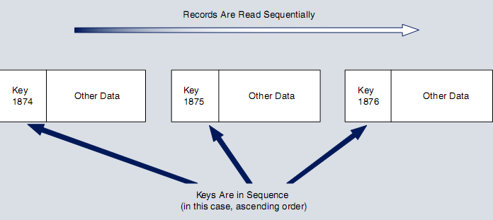
1. DATA STRUCTURES
1.1 Flat-File Structures
The flat-file model: individual data files are not integrated with other files. End users own their data files rather than share them w/ other users. Data files are structured, formatted, and arranged to suit the specific needs of the owner or primary user.
1.1.1 Sequential Structure (Sequential Access Method)
All records in the file lie in contiguous storage spaces in a specified sequence (ascending or descending) arranged by their primary key.
Sequential files are simple and easy to process. The application starts at the beginning of the file and processes each record in sequence.
Efficient only for large file data processing (step 4 and 5) (ex: payroll process).
The sequential access method
does not permit accessing
a record directly.
Example: vcd film

Slide 17
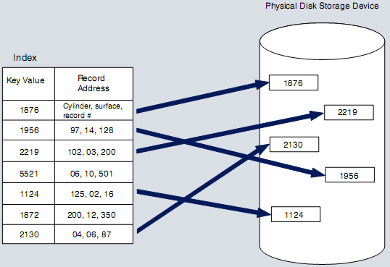
1. DATA STRUCTURES
1.1.2 Direct Access Structure
Direct Access Structure store data at a unique location known as an address, on a disk. The disk address is a numeric value, which is based on the record’s primary key. Example: bank account no., credit card numbers and license plate.
1.2.1.3 Indexed Structure (contoh: kaset)
This index contains the numeric value of the physical disk storage location for each record in the associated data file, may be organized either sequentially or randomly.
Records in an indexed random file are dispersed throughout a disk w/o regard for their physical proximity to other related
records. Locating record is accomplished
by searching the index for the desired key
value, reading the corresponding storage
location (address).
Appropriate for operations 1, 2, 3, and 6.
It also efficient use of disk storage.
Not efficient for operations that involve
processing a large portion of a file, while
sequential files are more efficient.

Slide 18
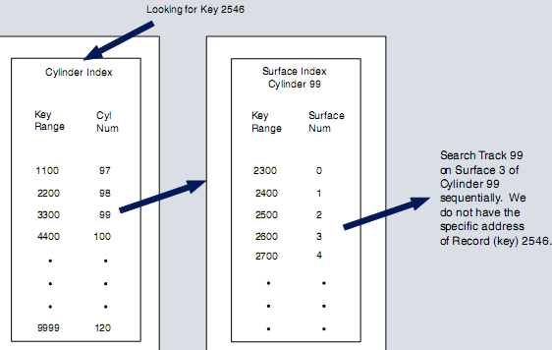
1. DATA STRUCTURES
1.1.2 Direct Access Structure
1.1.2.2 The Virtual Storage access method (VSAM)
VSAM structure is used for very large files that require routine batch processing and a moderate degree of individual record processing. Ex: the customer file of a public utility company will be processed in batch mode for billing purposes and directly accessed in response to individual customer queries.
The VSAM structure is moderately effective for Operations 1 and 3. Because VSAM must read multiple indexes and search the track sequentially, the average access time for a single record is slower.
The greatest disadvantage with
the VSAM structure is that it does
not perform record insertion
operations (Operation 2) efficiently.
For large, stable files that need
both direct access and batch
processing, the VSAM structure is
a popular option.

Slide 19
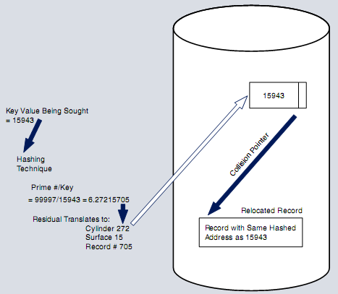
1. DATA STRUCTURES
1.1.2 Direct Access Structure
1.1.2.3 Hashing Structure
A hashing structure employs an algorithm that converts the primary key of a record directly into a storage address. The algorithm divides the inventory number (the primary key) into a prime number.
The calculation will always produce a value that can be translated into a storage location. Hence, the residual 6.27215705 becomes Cylinder 272, Surface 15, and Record number 705.
The advantage of hashing is access speed. This structure is suited for performing Operations 1, 2, 3, and 6.
The hashing structure has 2 significant disadvantages: (1) does not use storage space efficiently and (2) a collision might happen.

Slide 20
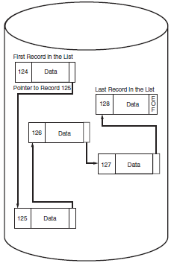
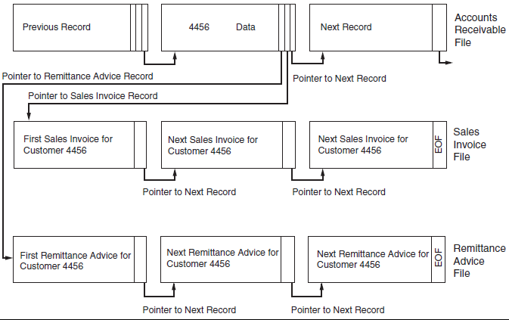
1. DATA STRUCTURES
1.1.2 Direct Access Structure
1.1.2.4 Pointer Structures
Linked-list file: This approach stores in a field of one record the address (pointer) of a related record. The pointers provide connections between the records. Ex: Record 124 points to the location of Record 125, Record 125 points to 126.
Pointers may be used to link records b/w files. Ex: AR record with three pointers.
1 pointer links the AR record to the next AR record.
2 and 3 pointers link AR records to sales invoice and remittance advice records. By accessing an AR record (Ex: Customer 4456), we can locate all sales invoices and remittances pertaining to the account.
1
3
2

Slide 21
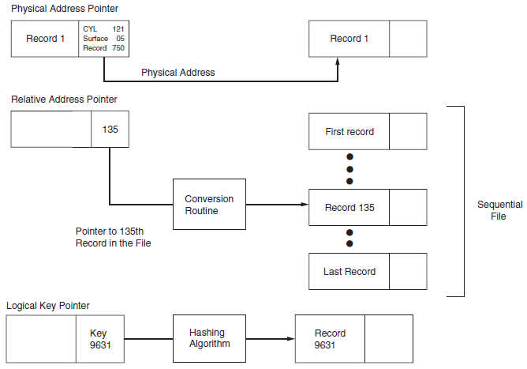
1. DATA STRUCTURES
1.1.2 Direct Access Structure
1.1.2.4 Pointer Structures, 3 Types of Pointers:
physical address: contains the actual disk storage location (cylinder, surface, and record number) needed by the disk controller. This physical address allows the system to access the record directly w/o obtaining further inf.
relative address: contains the relative position of a record in the file. Ex: the pointer
could specify the 135th record in the file. This must be further manipulated to convert it to the actual physical address (by using conversion software).
logical key pointer: contains the primary key of the related record. This key value is then converted into the record’s physical address by a hashing algorithm.

Slide 22
RELATIONAL DATABASES
A DBMS is characterized by the type of logical data model on which it is based.
A data model is an abstract representation of the contents of a database.
Most new DBMSs are called relational databases because they use the relational model developed by E. F. Codd in 1970.
The relational data model represents everything in the database as being stored in the forms of tables (aka, relations).

Slide 23
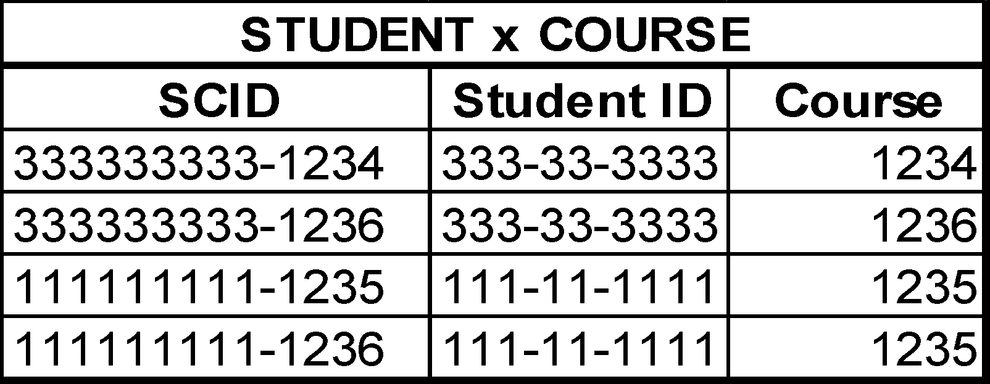
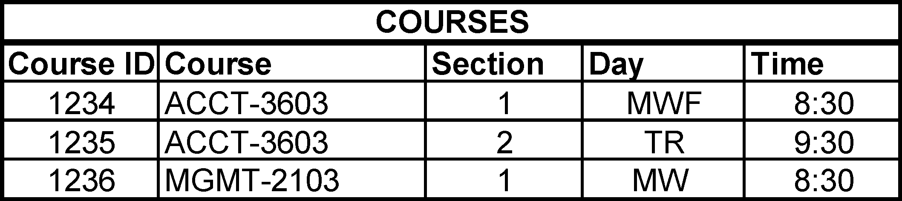
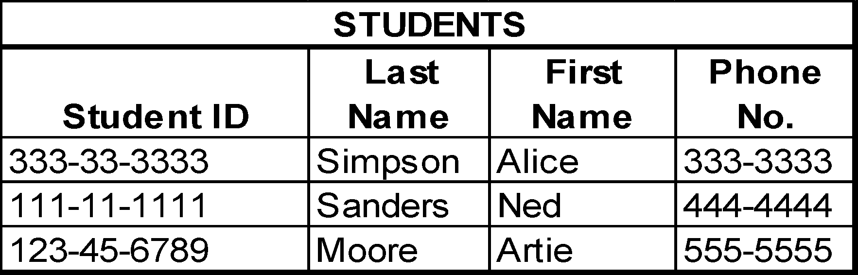
Relation

Slide 24
RELATIONAL DATABASES
This model only describes how the data appear in the conceptual- and external-level schemas.
The data are physically stored according to the description in the internal-level schema.

Slide 25
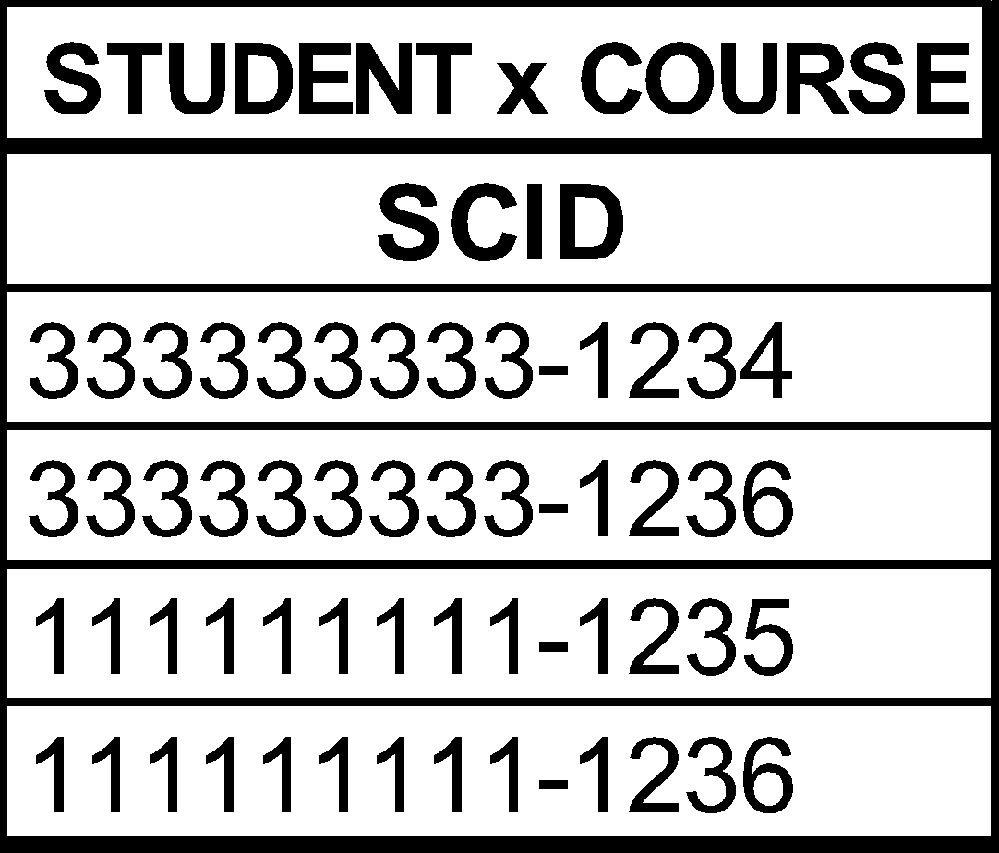
Each row is called a tuple, which rhymes with “couple.”

Slide 26
Each row contains data about a specific occurrence of the type of entity in the table.

Slide 27
Each column in a table contains information about a specific attribute of the entity.

Slide 28
A primary key is the attribute or combination of attributes that uniquely identifies a specific row in a table.

Slide 29
In some tables, two or more attributes may be joined to form the primary key.

Slide 30
STUDENTS
Student ID | Last Name | First Name | Phone No. | Advisor No.
333-33-3333 | Simpson | Alice | 333-3333 | 1418
111-11-1111 | Sanders | Ned | 444-4444 | 1418
123-45-6789 | Moore | Artie | 555-5555 | 1503
ADVISORS
Advisor No. | Last Name | First Name | Office No.
1418 | Howard | Glen | 420
1419 | Melton | Amy | 316
1503 | Zhang | Xi | 202
1506 | Radowski | J.D. | 203
A foreign key is an attribute in one table that is a primary key in another table.

Slide 31
STUDENTS
Student ID | Last Name | First Name | Phone No. | Advisor No.
333-33-3333 | Simpson | Alice | 333-3333 | 1418
111-11-1111 | Sanders | Ned | 444-4444 | 1418
123-45-6789 | Moore | Artie | 555-5555 | 1503
ADVISORS
Advisor No. | Last Name | First Name | Office No.
1418 | Howard | Glen | 420
1419 | Melton | Amy | 316
1503 | Zhang | Xi | 202
1506 | Radowski | J.D. | 203
Foreign keys are used to link tables together.

Slide 32
STUDENTS
Student ID | Last Name | First Name | Phone No. | Advisor No.
333-33-3333 | Simpson | Alice | 333-3333 | 1418
111-11-1111 | Sanders | Ned | 444-4444 | 1418
123-45-6789 | Moore | Artie | 555-5555 | 1503
ADVISORS
Advisor No. | Last Name | First Name | Office No.
1418 | Howard | Glen | 420
1419 | Melton | Amy | 316
1503 | Zhang | Xi | 202
1506 | Radowski | J.D. | 203
Other non-key attributes in each table store important information about the entity.

Slide 33
RELATIONAL DATABASES
Alternatives for storing data
One possible alternate approach would be to store all data in one uniform table.
For example, instead of separate tables for students and classes, we could store all data in one table and have a separate line for each student x class combination.

Slide 34
Student ID | Last Name | First Name | Phone No. | Course No. | Section | Day | Time
333-33-3333 | Simpson | Alice | 333-3333 | ACCT-3603 | 1 | M | 9:00 AM
333-33-3333 | Simpson | Alice | 333-3333 | FIN-3213 | 3 | Th | 11:00 AM
333-33-3333 | Simpson | Alice | 333-3333 | MGMT-3021 | 11 | Th | 12:00 PM
111-11-1111 | Sanders | Ned | 444-4444 | ACCT-3433 | 2 | T | 10:00 AM
111-11-1111 | Sanders | Ned | 444-4444 | MGMT-3021 | 5 | W | 8:00 AM
111-11-1111 | Sanders | Ned | 444-4444 | ANSI-1422 | 7 | F | 9:00 AM
123-45-6789 | Moore | Artie | 555-5555 | ACCT-3433 | 2 | T | 10:00 AM
123-45-6789 | Moore | Artie | 555-5555 | FIN-3213 | 3 | Th | 11:00 AM
Using the suggested approach, a student taking three classes would need three rows in the table.
In the above, simplified example, a number of problems arise.

Slide 35
Student ID | Last Name | First Name | Phone No. | Course No. | Section | Day | Time
333-33-3333 | Simpson | Alice | 333-3333 | ACCT-3603 | 1 | M | 9:00 AM
333-33-3333 | Simpson | Alice | 333-3333 | FIN-3213 | 3 | Th | 11:00 AM
333-33-3333 | Simpson | Alice | 333-3333 | MGMT-3021 | 11 | Th | 12:00 PM
111-11-1111 | Sanders | Ned | 444-4444 | ACCT-3433 | 2 | T | 10:00 AM
111-11-1111 | Sanders | Ned | 444-4444 | MGMT-3021 | 5 | W | 8:00 AM
111-11-1111 | Sanders | Ned | 444-4444 | ANSI-1422 | 7 | F | 9:00 AM
123-45-6789 | Moore | Artie | 555-5555 | ACCT-3433 | 2 | T | 10:00 AM
123-45-6789 | Moore | Artie | 555-5555 | FIN-3213 | 3 | Th | 11:00 AM
Suppose Alice Simpson changes her phone number. You need to make the change in three places. If you fail to change it in all three places or change it incorrectly in one place, then the records for Alice will be inconsistent.
This problem is referred to as an update anomaly.

Slide 36
Student ID | Last Name | First Name | Phone No. | Course No. | Section | Day | Time
333-33-3333 | Simpson | Alice | 333-3333 | ACCT-3603 | 1 | M | 9:00 AM
333-33-3333 | Simpson | Alice | 333-3333 | FIN-3213 | 3 | Th | 11:00 AM
333-33-3333 | Simpson | Alice | 333-3333 | MGMT-3021 | 11 | Th | 12:00 PM
111-11-1111 | Sanders | Ned | 444-4444 | ACCT-3433 | 2 | T | 10:00 AM
111-11-1111 | Sanders | Ned | 444-4444 | MGMT-3021 | 5 | W | 8:00 AM
111-11-1111 | Sanders | Ned | 444-4444 | ANSI-1422 | 7 | F | 9:00 AM
123-45-6789 | Moore | Artie | 555-5555 | ACCT-3433 | 2 | T | 10:00 AM
123-45-6789 | Moore | Artie | 555-5555 | FIN-3213 | 3 | Th | 11:00 AM
What happens if you have a new student to add, but he hasn’t signed up for any courses yet?
Or what if there is a new class to add, but there are no students enrolled in it yet? In either case, the record will be partially blank.
This problem is referred to as an insert anomaly.

Slide 37
Student ID | Last Name | First Name | Phone No. | Course No. | Section | Day | Time
333-33-3333 | Simpson | Alice | 333-3333 | ACCT-3603 | 1 | M | 9:00 AM
333-33-3333 | Simpson | Alice | 333-3333 | FIN-3213 | 3 | Th | 11:00 AM
333-33-3333 | Simpson | Alice | 333-3333 | MGMT-3021 | 11 | Th | 12:00 PM
111-11-1111 | Sanders | Ned | 444-4444 | ACCT-3433 | 2 | T | 10:00 AM
111-11-1111 | Sanders | Ned | 444-4444 | MGMT-3021 | 5 | W | 8:00 AM
111-11-1111 | Sanders | Ned | 444-4444 | ANSI-1422 | 7 | F | 9:00 AM
123-45-6789 | Moore | Artie | 555-5555 | ACCT-3433 | 2 | T | 10:00 AM
123-45-6789 | Moore | Artie | 555-5555 | FIN-3213 | 3 | Th | 11:00 AM
If Ned withdraws from all his classes and you eliminate all three of his rows from the table, then you will no longer have a record of Ned. If Ned is planning to take classes next semester, then you probably didn’t really want to delete all records of him.
This problem is referred to as a delete anomaly.

Slide 38
RELATIONAL DATABASES
Alternatives for storing data
Another possible approach would be to store each student in one row of the table and create multiple columns to accommodate each class that he is taking.

Slide 39
Student ID | Last Name | First Name | Phone No. | Class 1 | Class 2 | Class 3 | Class 4
333-33-3333 | Simpson | Alice | 333-3333 | ACCT-3603 | FIN-3213 | MGMT-3021
111-11-1111 | Sanders | Ned | 444-4444 | ACCT-3433 | MGMT-3021 | ANSI-1422
123-45-6789 | Moore | Artie | 555-5555 | ACCT-3433 | FIN-3213
This approach is also fraught with problems:
How many classes should you allow in building the table?
The above table is quite simplified. In reality, you might need to allow for 20 or more classes (assuming a student could take many 1-hour classes). Also, more information than just the course number would be stored for each class. There would be a great deal of wasted space for all the students taking fewer than the maximum possible number of classes.
Also, if you wanted a list of every student taking MGMT-3021, notice that you would have to search multiple attributes.

Slide 40
The solution to the preceding problems is to use a set of tables in a relational database.
Each entity is stored in a separate table, and separate tables or foreign keys can be used to link the entities together.

Slide 41
RELATIONAL DATABASES
Basic requirements of a relational database
Every column in a row must be single valued.
In other words, every cell can have one and only one value.
In the student table, you couldn’t have an attribute named “Phone Number” if a student could have multiple phone numbers.
There might be an attribute named “local phone number” and an attribute named “permanent phone number.”
You could not have an attribute named “Class” in the student table, because a student could take multiple classes.

Slide 42
RELATIONAL DATABASES
Basic requirements of a relational database
The primary key cannot be null.
The primary key uniquely identifies a specific row in the table, so it cannot be null, and it must be unique for every record.
This rule is referred to as the entity integrity rule.

Slide 43
Note that within each table, there are no duplicate primary keys and no null primary keys.
Consistent with the entity integrity rule.

Slide 44
RELATIONAL DATABASES
Basic requirements of a relational database
A foreign key must either be null or correspond to the value of a primary key in another table.
This rule is referred to as the referential integrity rule.
The rule is necessary because foreign keys are used to link rows in one table to rows in another table.

Slide 45
STUDENTS
Student ID | Last Name | First Name | Phone No. | Advisor No.
333-33-3333 | Simpson | Alice | 333-3333 | 1418
111-11-1111 | Sanders | Ned | 444-4444 | 1418
123-45-6789 | Moore | Artie | 555-5555 | 1503
ADVISORS
Advisor No. | Last Name | First Name | Office No.
1418 | Howard | Glen | 420
1419 | Melton | Amy | 316
1503 | Zhang | Xi | 202
1506 | Radowski | J.D. | 203
Advisor No. is a foreign key in the STUDENTS table. Every incident of Advisor No. in the STUDENTS table either matches an instance of the primary key in the ADVISORS table or is null.

Slide 46
RELATIONAL DATABASES
Basic requirements of a relational database
All non-key attributes in a table should describe a characteristic of the object identified by the primary key.
Could nationality be a non-key attribute in the student table?
Could advisor’s nationality be a non-key attribute in the student table?

Slide 47
RELATIONAL DATABASES
The preceding four constraints produce a well-structured (normalized) database in which:
Data are consistent.
Redundancy is minimized and controlled.
In a normalized database, attributes appear multiple times only when they function as foreign keys.
The referential integrity rule ensures there will be no update anomaly problem with foreign keys.

Slide 48
RELATIONAL DATABASES
An important feature is that data about various things of interest (entities) are stored in separate tables.
Makes it easier to add new data to the system.
You add a new student by adding a row to the student table.
You add a new course by adding a row to the course table.
Means you can add a student even if he hasn’t signed up for any courses.
And you can add a class even if no students are yet enrolled in it.
Makes it easy to avoid the insert anomaly.
Space is also used more efficiently than in the other schemes. There should be no blank rows or attributes.

Slide 49
Add a student here.
Leaves no blank spaces.
Add a course here.
Leaves no blank spaces.
When a particular student enrolls for a particular course, add that info here.

Slide 50
RELATIONAL DATABASES
Deletion of a class for a student would cause the elimination of one record in the student x class table.
The student still exists in the student table.
The class still exists in the class table.
Avoids the delete anomaly.

Slide 51
Ned still exists in the student table.
Even if Ned was the only student in the class, ACCT-3603 still exists in the course table.
If Ned Sanders drops ACCT-3603, remove Ned’s class from this table.

Slide 52
3. Relational DB Structure, Concepts, and Terminology
Relational Database Concepts
Associations and Cardinality
The labeled line connecting two entities in a data model describes the nature of the association between them. This association is represented with a verb, such as ships, requests, or receives.
Cardinality is the degree of association between two entities. Simply stated, cardinality describes the number of possible occurrences in one table that are associated with a single occurrence in a related table. Four basic forms of cardinality are possible: zero or one (0,1), one and only one (1,1), zero or many (0,M), and one or many (1,M).
The value of the upper cardinalities at each end of the association line defines the association. Example, a (0,1) cardinality at one end and a (1,M) cardinality at the other is a (1:M) association.

Slide 53


3. Relational DB Structure, Concepts, and Terminology
Minimum
Maximum
Relational Database Concepts
Associations and Cardinality
Example 1 (1:1).
A company has 1,000 employees but only 100 of them are sales staff.
Each salesperson is assigned a company car, but nonsales staff are not.
Example 1 shows that for every occurrence (record) in the Employee entity, there is a possibility of zero or one occurrence in the Company Car entity.
When determining the cardinality values in an entity association, select a single occurrence (record) of one entity and answer: What are min and max number of records that may be associated w/ single record that has been selected?
Example 2 (1:1).
Illustrates each record in one entity is always associated with one (and only one) record in the associated entity. Each company laptop computer is assigned to only 1 mgr,
and every mgr is assigned
only 1 computer.

Slide 54



3. Relational DB Structure, Concepts, and Terminology
Associations and Cardinality
Example 3 (1:M).
Presents the relationship between Customer and Sales Order entities. Notice that min number of SO records per Customer record is zero and max is many.
Example 4 (1:M).
Each specific item of inventory is supplied by one and only one Vendor, and each Vendor supplies one or many different inventory items to the company.
Example 5 (M:M).
Use a Vendor and Inventory relationship, this time, however, the company has a policy of purchasing the same types of inventory from multiple suppliers.
The database designer must obtain a thorough understanding of how the client-company and specific users conduct business to properly design the data model. Examples 4 and 5 are both valid but different options and, as we shall see, require different database designs.

Slide 55
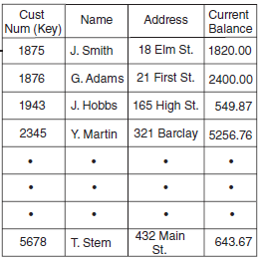
3. Relational DB Structure, Concepts, and Terminology
The Physical Database Tables
Across the top of each table are attributes forming columns.
Intersecting the columns to form the rows of the table are record or occurrence.
Properly designed tables possess the following 4 characteristics:
The value of at least 1 attribute in each occurrence (row) must be unique (i.e. the primary key). The values of the other (nonkey) attributes need not be unique.
All attribute values in any column must be of the same class.
Each column in a given table must be uniquely named.
Tables must conform to the rules of normalization, means they must be free from structural dependencies including :
repeating groups,
partial dependencies, and
transitive dependencies.

Slide 56
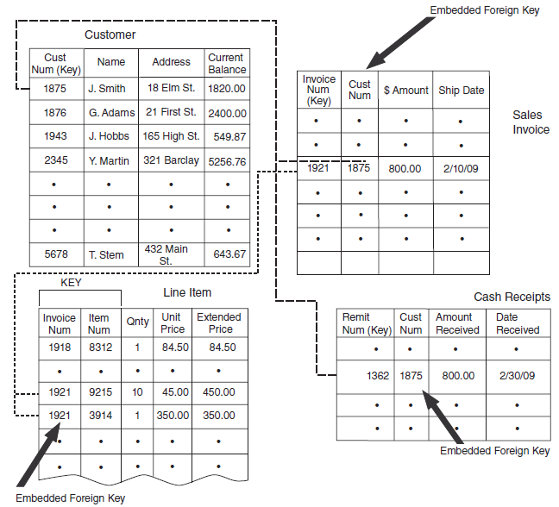
3. Relational DB Structure, Concepts, and Terminology
Linkages between Relational Tables
Logically related tables need to be physically connected to achieve the associations described in the data model. Using foreign keys accomplishes this, as illustrated.
Note: Line Item table uses a composite primary key comprised of INVOICE NUM and ITEM NUM. Both fields are needed to identify each record in the table uniquely.
Ex: a user wants all invoices for Customer 1875, program will search Sales Invoice table for records w/ a foreign key value of 1875. To obtain the line-item details, program searches the Line Item table for records with a foreign key value of 1921, and 2 records are retrieved.

Slide 57
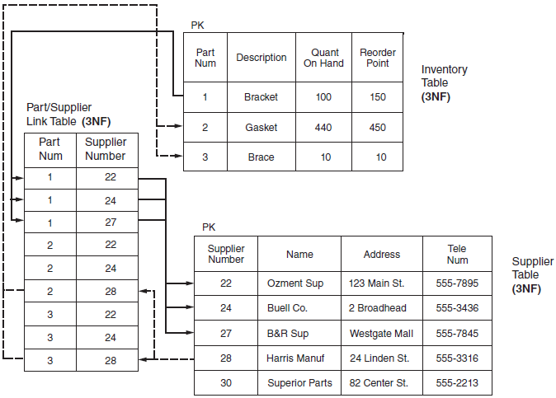
4. Anomalies, Structural Dependencies, Normalization
Normalizing Tables
The database anomalies are symptoms of structural problems within tables called dependencies. These are known as repeating groups, partial dependencies, and transitive dependencies. The normalization process involves identifying and removing structural dependencies from the table(s) under review.
The resulting tables meet 2 conditions:
All nonkey (data) attributes in table are dependent on (defined by) primary key.
All nonkey attributes are independent of the other nonkey attributes.

Slide 58
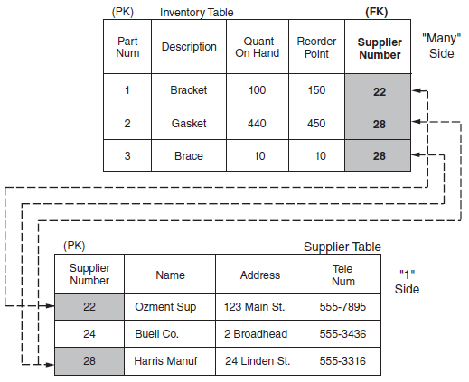
4. Anomalies, Structural Dependencies, Normalization
Linking Normalized Tables
When unnormalized tables are split into multiple 3NF tables, they need to be linked together via foreign keys so the data in them can be related and made accessible to users. The degree of association (joint cardinality) between the resulting tables (that is, 1:1, 1:M, or M:M) determines how the linking occurs.
Keys in 1:1 Associations. Where a true 1:1 association exists between tables, either (or both) primary keys may be embedded as foreign keys in the related table.
Keys in 1:M Associations. Where a 1:M (or 1:0,M) association exists, the primary key of the 1 side is embedded in the table of the M side (lihat gambar).
Keys in M:M Associations. To represent the M:M association between tables, a link table needs to be created. The link table has a combined (composite) key consisting of the primary keys of two related tables.

Slide 59
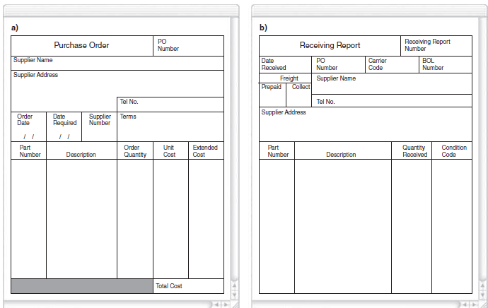
5. DESIGNING RELATIONAL DATABASES
The six phases of database design (view modeling):
1. Identify entities.
2. Construct a data model showing entity associations.
3. Add primary keys and attributes to the model.
4. Normalize the data model and add foreign keys.
5. Construct the physical database.
6. Prepare the user views.
1. Identify Entities
The entities are things which org wishes to capture data. Ex: Inventory, Supplier, and PO
To pass as valid entities, two conditions need to be met:
Condition 1: Entity must consist > 2 occurrence
Condition 2: Entity must contri-bute at least 1 attribute that is not provided by other entities.

Slide 60
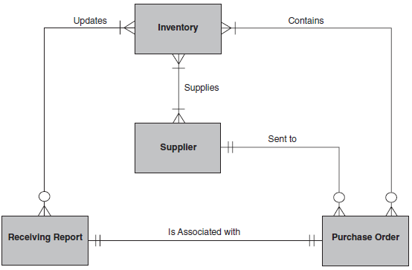
5. DESIGNING RELATIONAL DATABASES
2. Construct a Data Model Showing Entity Associations
The next step is to determine the associations between entities and document them with an ER diagram. Example: the normal association b/w a Customer entity and a Sales Order entity is 1:M (or 1:0,M).
There is a 0,M:M association b/w PO and Inventory entities.
There is an M:M association b/w Inventory and Supplier entities.
There is a 1:0,M association b/w Supplier and PO entity, means: each supplier
may have received zero or many PO, but each order goes to only one supplier.
There is a 1:1 association b/w PO and RR entities.
Association b/w RR and Inventory entities is 0,M:M.
M:M and 0,M:M associations in the data model need to be resolved before the physical databases can be created.

Slide 61
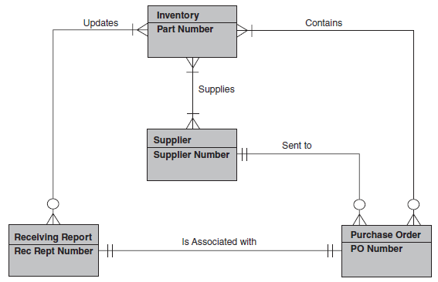
5. DESIGNING RELATIONAL DATABASES
3. Add Primary Keys and Attributes to the Model
Add Primary Keys.
Select a primary key that logically defines the nonkey attributes and uniquely identifies each occurrence in the entity.

Slide 62
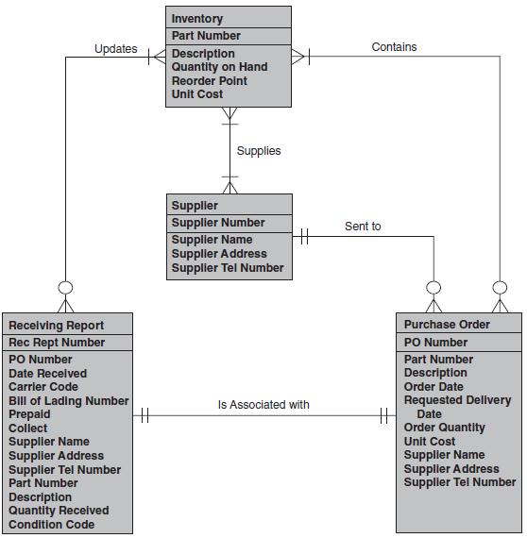
5. DESIGNING RELATIONAL DATABASES
3. Add Primary Keys and Attributes to the Model
Add Attributes.
Entity attributes are originally derived and modeled from user views. If stored data are not used in a document, report, or a calculation that is reported in some way, then it serves no purpose and should not be part of the database.

Slide 63
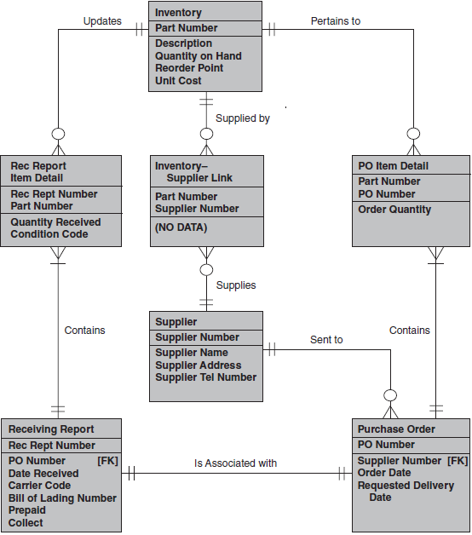
5. DESIGNING RELATIONAL DATABASES
4. Normalize Data Model and
Add Foreign Keys
Repeating Group Data in Purchase Order.
Repeating Group Data in Receiving Report.
Transitive Dependencies. The PO and Receiving Report entities contain attributes that are redundant with data in the Inventory and Supplier entities.
New Entity
New Entity
New Entity

Slide 64
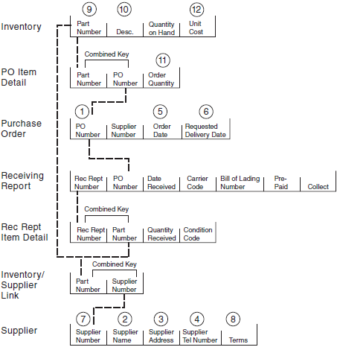
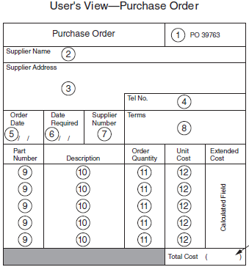
5. DESIGNING RELATIONAL DATABASES
5. Construct Physical
Database
Normalized Tables

